Slide 1
B.E. Project - I (CEC23)
Submitted by -
Abhishek Singh
2017UCO1582
Akash Singh 2017UCO1592
Rahul Meena 2017UCO1598
Ankit Arya 2017UCO1629
AI Voice Assistant
Supervised By -
Associate Professor Dr. Veenu

Slide 2
Objectives
To Create AI integrated Voice Assistant that is privacy friendly and can be used on Linux, Ubuntu which does not have an integrated voice assistant like Windows has Cortana and MacOS has Siri.
We have tried to make a tailor-based Assistant that can be used by any organization , group or community with just minor changes.
It can also be installed on Windows and Mac OS for privacy protection as no data is stored on the cloud and the Machine Learning models are on the device of the User
It has been aimed that future extension of the Al Voice Assistant to other system/devices is not a big hurdle.

Slide 3
Working of the Project
Wake word detection: This will wake up our voice assistant like google uses Ok google, apple uses Hey Siri we will have happy as wake word.
Automatic speech Recognition: This will detect whatever the user is saying after the wake word and store it.
Natural Language Understanding: In this module, the voice assistant will try to make sense of what user has said and do the task told by user
Speech Synthesis: This model will generate sound waves and speak whatever appropriate response is formed e.g temperature is 15 degree
To do all of this we will use Python as our programming language and Pytorch, a machine learning framework in Python that will help train and test machine learning models, and to use the models once they are trained we will use flask so that they can be used in a webapp.

Slide 4
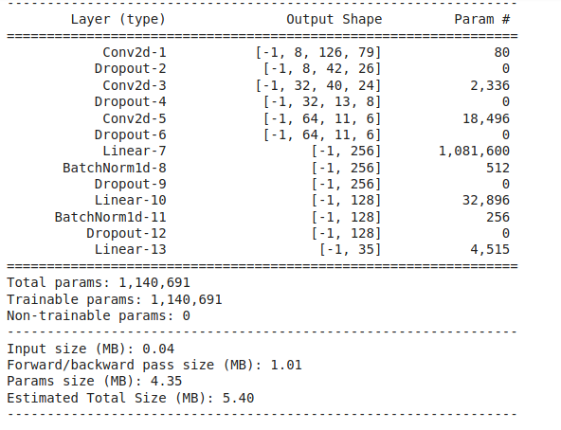
WakeWord
Model Architecture of WakeWord Model
A wake word is a word or phrase that when spoken is meant to activate a device. It is also referred to as 'trigger word', or 'wake up word’.
There are a few famous wake phrases such as "Alexa" "Hey Siri", and "OK Google" .
For our project we have used “happy” as our wake word which when said will wake up the AI engine.

Slide 5
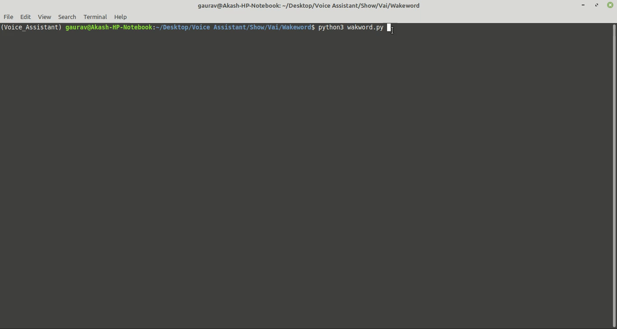
For Training wakeword we used Google speech commands dataset this dataset contains 1,10,000 one-second-long utterances of 35 short words.
For exploration and processing we used librosa and torchaudio libraries.
The sounds had the sampling rate of 16,000 samples/sec with varying length of about one second so before using it we truncated or padded to make it of length 1second each
RESULT

Slide 6
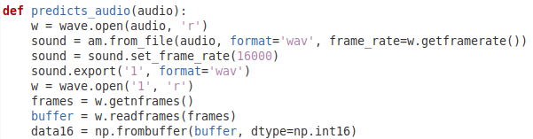
Speech to Text
The model expects the audio file that is being used as input should be sampled at 16,000Hz but depending upon the type of microphone being used and the operating system settings, audio could be sampled at any frequency, so to handle this, we need to resample the frequency at 16,000Hz and convert it to NumPy int so the model can understand it and work with it.
Speech to text or automatic speech recognition (ASR), is the process of converting spoken words into written text it is also known as speech recognition.
In our project we have used Deep Speech a deep learning-based speech recognition model that will convert speech into text for us.

Slide 7
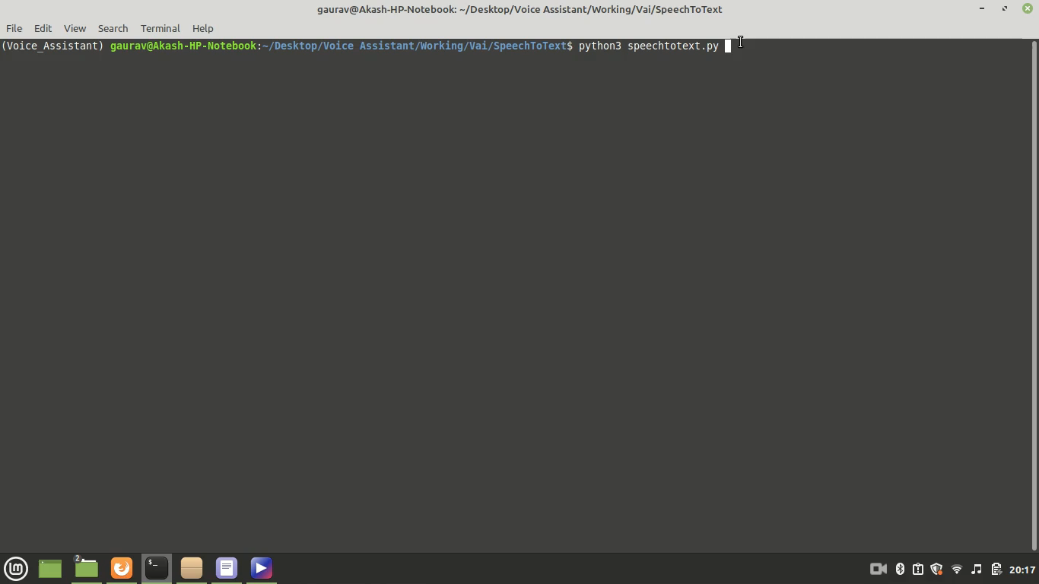

Slide 8
NLU
Natural language understanding (NLU) comes under Artificial Intelligence (AI), which involves breaking down the human language into a machine understandable format.
NLU tries to understand grammatical rules and syntax of the language so that it can make sense of the data.
NLU makes it possible for machines to understand context and meaning of “natural language,”.
In our project we have used NLU to classify the intent of our speech in various categories so we can tell the machine whether it needs to open a file, search for something or do some calculations.
Data Preprocessing and Feature Extraction
Our dataset is in json format
labels tag
intent and its corresponding response
first step is to make the string in lowercase
remove punctuations and stopwords from it.
Tokenization is a way of separating a piece of text into smaller units called tokens. Here, tokens can be either words, characters, or subwords. We have done word tokenization converting user’s query into tokens using nltk module.
Stemming is the process of reducing a word to its word stem that affixes to suffixes and prefixes or to the roots of words known as a lemma. After we have done tokenization every token is converted into its root word for this we have used PorterStemmer.
Bag_of_words: A bag of words is a representation of text that describes the occurrence of words within a document. We just keep track of word counts and disregard the grammatical details and the word order. We have used our training data to make a bag of words.

Slide 9
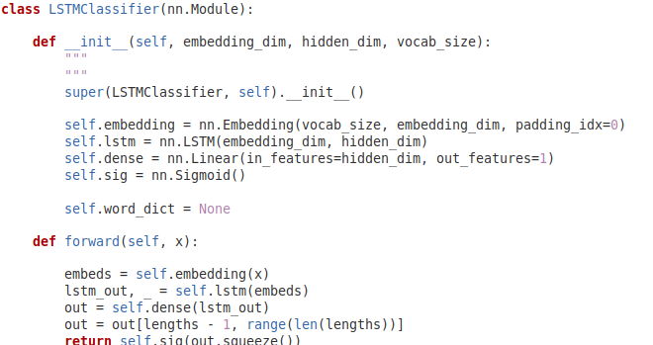
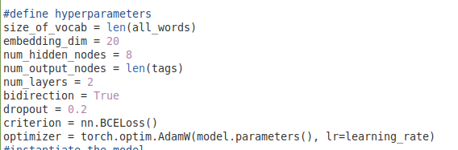
To provide more of an individualized experience to the user’s we have provided the user with an option to enter his google credentials and then we will fetch his history using selenium and the model will train on it automatically from time to time.
NLU model
Hyperparameters for training

Slide 10
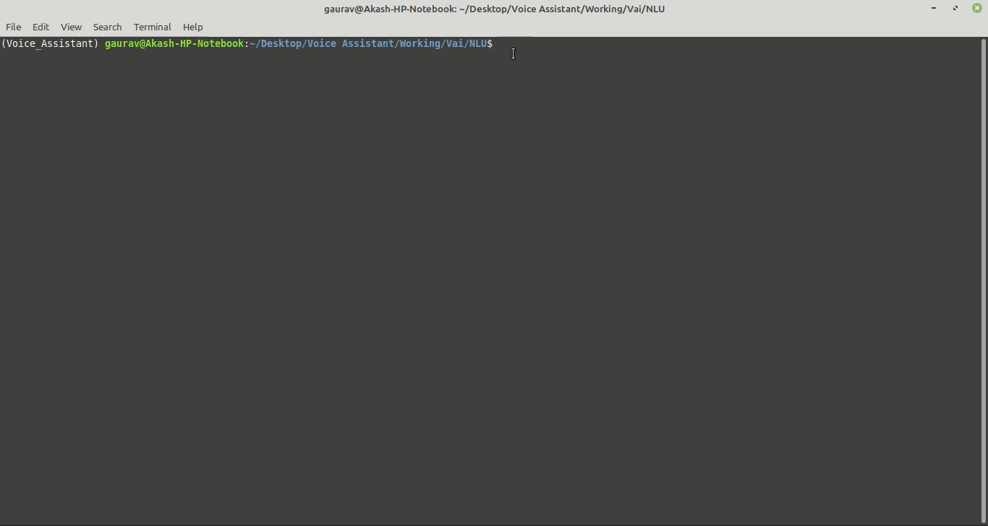

Slide 11
Text to Speech
Data Analysis and Pre-processing
For speech to text we used Lj Speech Dataset which consists of 13,100 short audio clips transcription is also provided for each clip in metadata.csv. Clips present in the dataset vary from length 1 to 10 seconds and have a total length of approximately 24 hours.
Each audio file present in the dataset is a single-channel 16-bit PCM WAV with a sampled at the rate of 22050 Hz.
Metadata about the dataset is provided in metadata.csv. The fields present in the metadata.csv are:
ID: denoting name of the.wav file
Transcription: words spoken in the audio file
Normalized Transcription: This contains transcription with numbers, ordinals, and monetary units expanded into full words (UTF-8).
A text-to-speech (TTS) is that the artificial production of human speech for a given text.
This model will generate sound waves and speak whatever appropriate response is formed e.g temperature is 15 degree
Feature Extraction
Mel-Spectrogram: The MelSpectrogram is a spectrogram in which the y-axis is the Mel scale and the x-axis is timeIn our SpeechToText model after pre-processing the audio wave they are converted into normalized melspectogram and magnitude spectrogram. We have used 80 mel banks filters to extract features from the audio file.

Slide 12
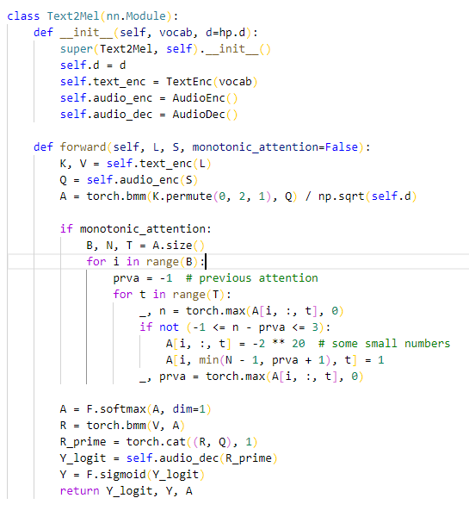
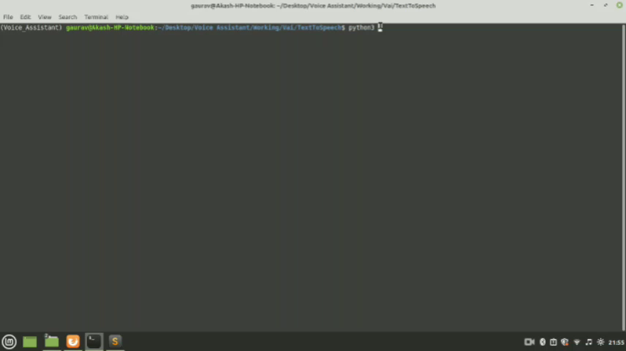

Slide 13
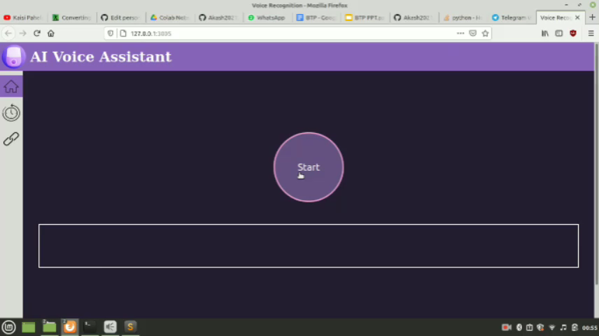

Slide 14
Application and Future Scope
Future Aspects / Scope of our work
Individualized Experiences
Since every user is unique and so are there needs so in the future it should be possible for the Voice Assistant to learn the expectation of a user when they are searching for something and produce results accordingly or if they want to see their schedule or remainders it should act like a personal assistant not as a general assistant.
Voice Push Notifications
Using Voice Assistant users should be able to use other different apps like scheduling meetings, booking cab and voice assistant should be able to speak or show us those notifications from many different applications.
Focus on Security
With the increase of dependence of a user on technologies their security should also increase in the future as Voice Assistant learns more about us it will be able to book restaurants for us to plan out our evening buy tickets so it becomes important for us to make sure that no one else has the access to our data.
Application
Voice assistants can provide a wide variety of services like
1. Perform searches on internet
2. Open your favorite website
3. Get information from Wikipedia
4. Perform basic OS tasks e.g shutdown, reboot, open apps
5. Learn from your history and show you information that’s relevant to you.

Slide 15
References
[1]Hideyuki Tachibana, Katsuya Uenoyama, Shunsuke Aihara, ”Efficiently Trainable Text-to-Speech System Based on Deep Convolutional Networks with Guided Attention”
[2]Christin Jose, Yuriy Mishchenko, Thibaud Senechal, Anish Shah, Alex Escott, Shiv Vitaladevuni, ”Accurate Detection of Wake Word Start and End Using a CNN”
[3]Giovanni Di Gennaro, Amedeo Buonanno, Antonio Di Girolamo, Armando Ospedale, Francesco A.N. Palmieri, ”Intent Classification in Question-Answering Using LSTM Architectures”
[4]Dario Amodei, Rishita Anubhai, ”Deep Speech 2: End-to-End Speech Recognition in English and Mandarin”
[5]Jakub Nowak(Czestochowa University of Technology), Ahmet Taspinar, Rafal Scherer(Czestochowa University of Technology), ”LSTM Recurrent Neural Networks for Short Text and Sentiment Classification”

Slide 16
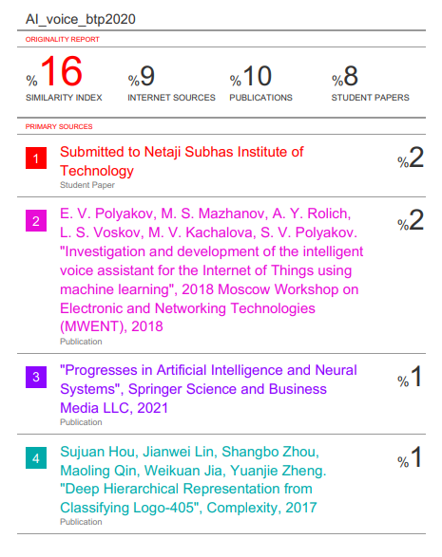
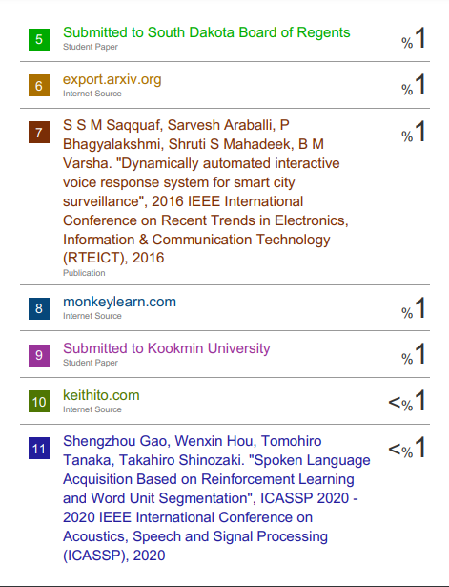
PLAGIARISM REPORT

Slide 17
Thank You

